Slide 1

Algebra 1
Unit 2, Lesson 9 Dividing Polynomials Volume 1, pg. 100

Slide 2


Benchmark
MA.912.AR.1.4
Divide a polynomial expression by a monomial expression with rational number coefficients.
volume 1, pg. 100

Slide 3
Integrated Mathematical Thinking and Reasoning Standards
MA.K12.MTR.2.1 Demonstrate understanding by representing problems in multiple ways.
MA.K12.MTR.3.1 Complete tasks with mathematical fluency.
MA.K12.MTR.4.1 Engage in discussions that reflect on the mathematical thinking of self and others.
MA.K12.MTR.5.1 Use patterns and structure to help understand and connect mathematical concepts.
volume 1, pg. 100

Slide 4

Learning Target
I can divide a polynomial expression by a monomial expression.
volume 1, pg. 100

Slide 5

Warm-Up
volume 1, pg. 101

Slide 6

2.9.1 Warm-Up: Bell Work
Simplify each expression.
$1.3u\left(4u^{5}+7t\right)$
$\left(\frac{7}{10}g^{3}+{\frac{12}{5}g}^{2}\right)+{(35g}^{4}+6g^{2}−10g)$
$\left(7x^{3}y−\frac{49}{10}xy\right)−\left(−\frac{11}{10}x^{3}y+ \frac{3}{5}xy+7xy^{2}\right)$
volume 1, pg. 101
Notes:
Video Link: https://algebranation.wistia.com/medias/fi4fidi5y8

Slide 7

Guided Instruction
volume 1, pg. 101

Slide 8

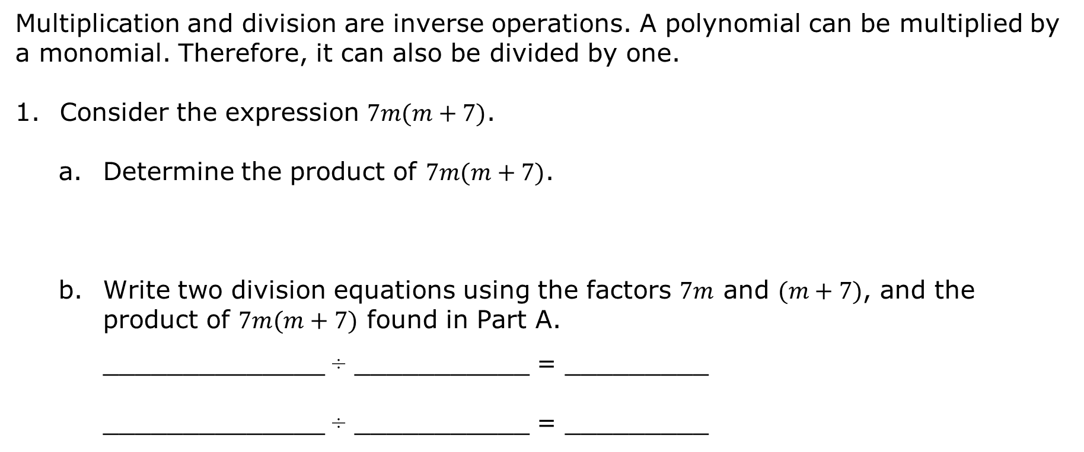
2.9.2 Guided Instruction: Dividing Polynomials by Monomials
Multiplication and division are inverse operations. A polynomial can be multiplied by a monomial. Therefore, it can also be divided by one.
Consider the expression $7m(m+7)$.
Determine the product of $7m(m+7)$.
Write two division equations using the factors $7m$ and $(m+7)$, and the product of $7m(m+7)$ found in Part A.
______________ ÷ ___________ = _________
______________ ÷ ___________ = _________
volume 1, pg. 101

Slide 9
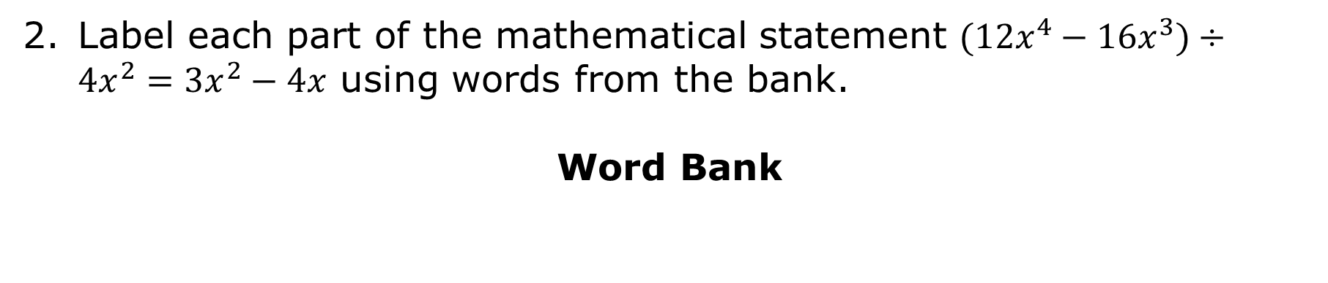
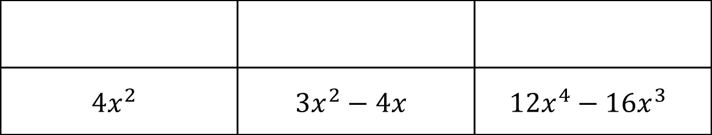
Label each part of the mathematical statement $(12x^{4}−16x^{3})÷4x^{2}=3x^{2}−4x$ using words from the bank.
Word Bank
$$4x^{2}$$ | $$3x^{2}−4x$$ | $$12x^{4}−16x^{3}$$
volume 1, pg. 101

Slide 10
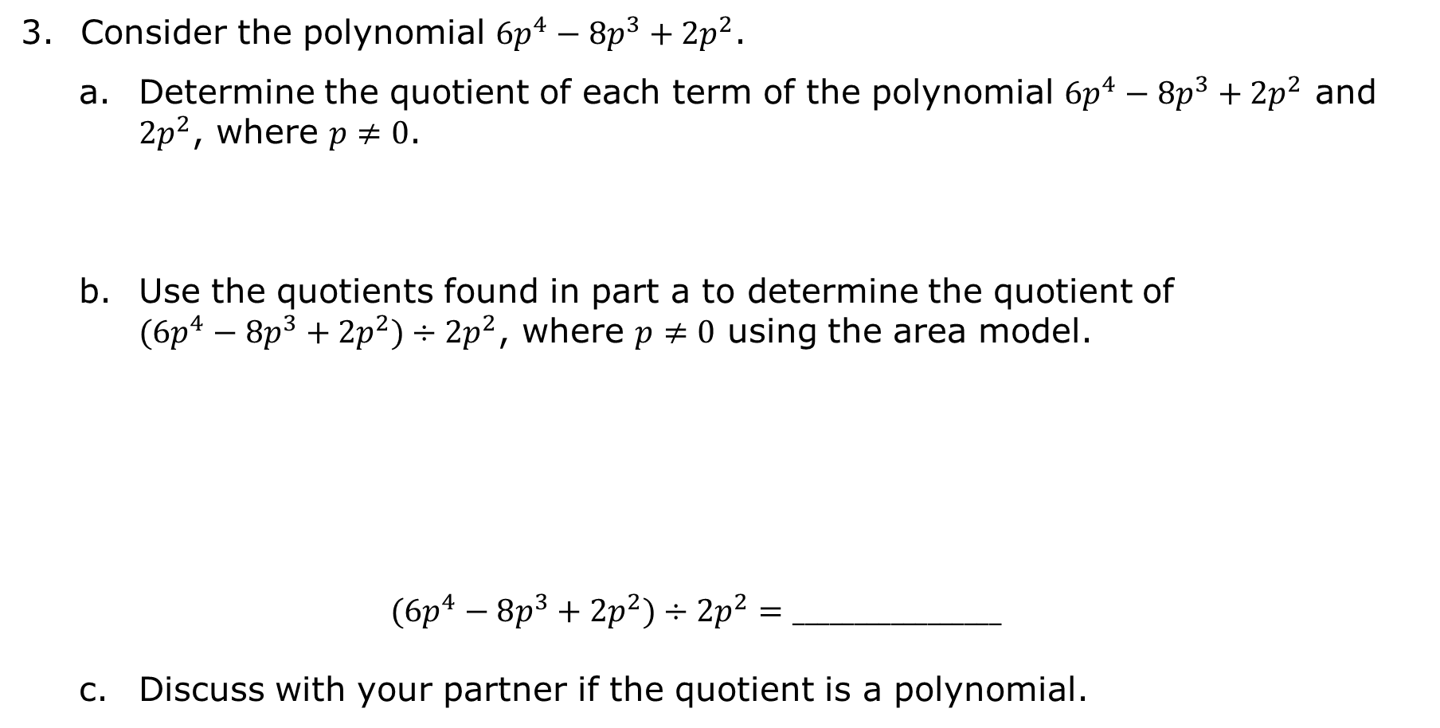
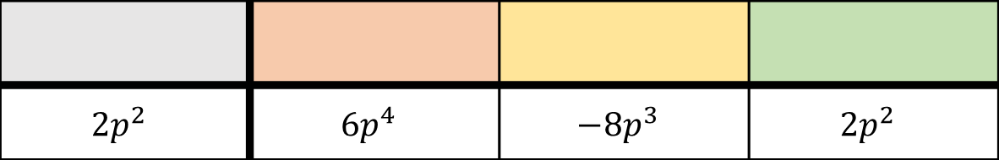
Consider the polynomial $6p^{4}−8p^{3}+2p^{2}$.
Determine the quotient of each term of the polynomial $6p^{4}−8p^{3}+2p^{2}$ and $2p^{2}$, where $p≠0$.
Use the quotients found in part a to determine the quotient of $(6p^{4}−8p^{3}+2p^{2})÷2p^{2}$, where $p≠0$ using the area model.
$$(6p^{4}−8p^{3}+2p^{2})÷2p^{2}=_________________$$
Discuss with your partner if the quotient is a polynomial.
${6p}^{4}÷{2p}^{2}=$ ____ | ${−8p}^{3}÷{2p}^{2}=$ ____ | $2p^{2}÷{2p}^{2}=$ ____
$${2p}^{2}$$ | $${6p}^{4}$$ | $${−8p}^{3}$$ | $$2p^{2}$$
volume 1, pg. 102

Slide 11
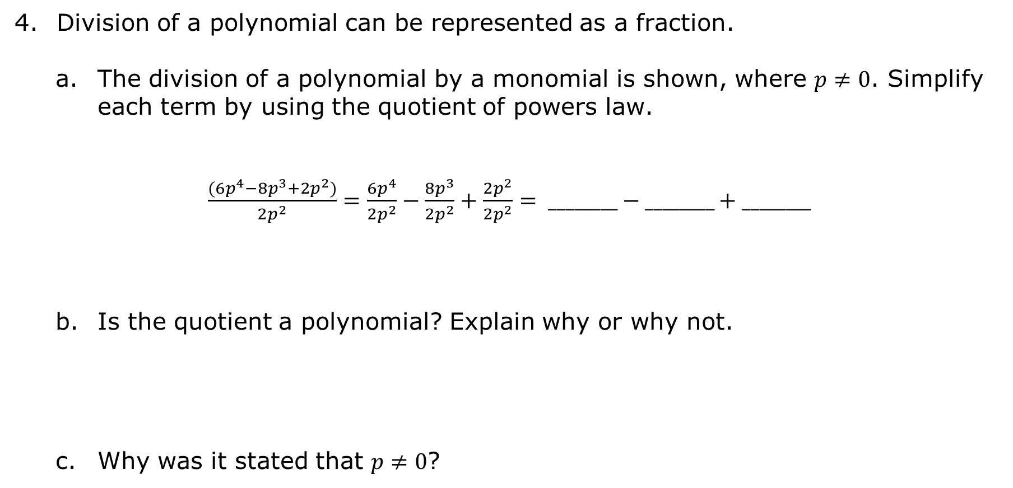
Division of a polynomial can be represented as a fraction.
The division of a polynomial by a monomial is shown, where $p≠0$. Simplify each term by using the quotient of powers law.
$\frac{(6p^{4}−8p^{3}+2p^{2})}{2p^{2}}=\frac{6p^{4}}{2p^{2}}−\frac{8p^{3}}{2p^{2}}+\frac{2p^{2}}{2p^{2}}= ________−________+________$
Is the quotient a polynomial? Explain why or why not.
Why was it stated that $p≠0$?
volume 1, pg. 102

Slide 12
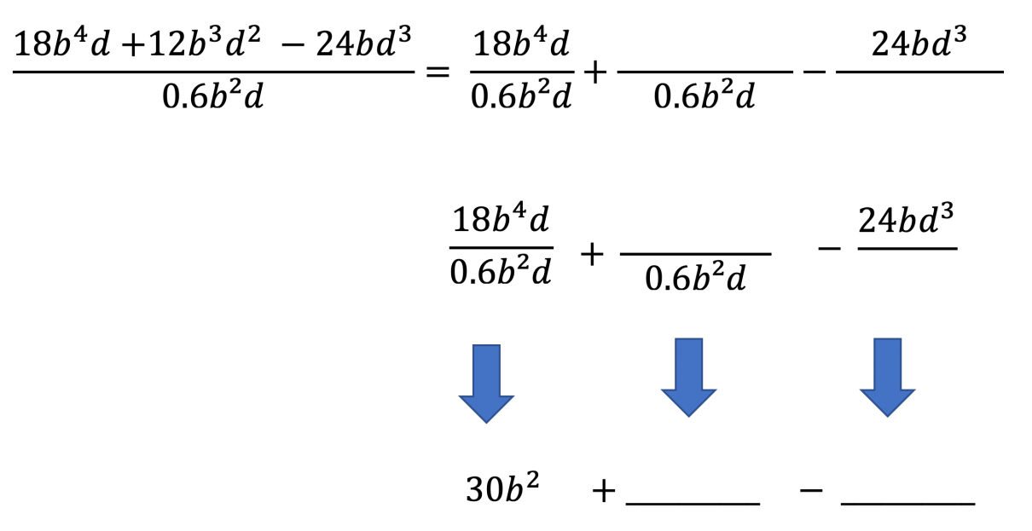
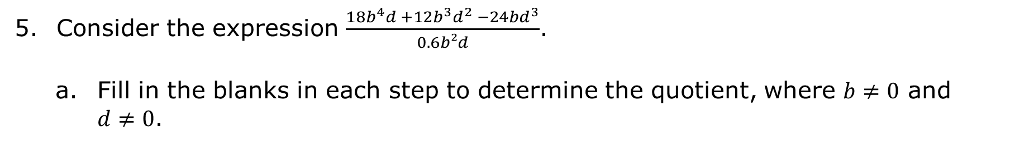
Consider the expression $\frac{{18b}^{4}d {+12b}^{3}d^{2} −24bd^{3}}{0.6b²d}$.
Fill in the blanks in each step to determine the quotient, where $b≠0$ and $d≠0$.
volume 1, pg. 103

Slide 13
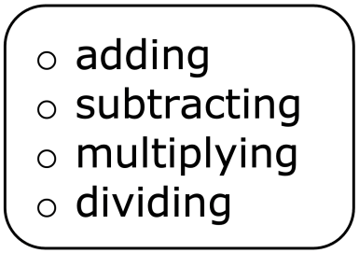

Discuss with your partner why the quotient is not a polynomial. Summarize your discussion.
Complete that statement.
The result of a polynomial
a polynomial will not always result in a polynomial.
volume 1, pg. 103

Slide 14

Guided Practice
volume 1, pg. 103

Slide 15


2.9.3 Guided Practice: Dividing Polynomials by Monomials
Use the area model to find $(3ac+2.1a^{3}c−1.5ac^{2})÷3ac$, where $a≠0$ and $c≠0$.
Find the quotient if $x≠0$ and $y≠0$.
$$\frac{56x^{2}y^{2}−16x^{2}y^{4}−48x^{4}y^{3}}{−8x^{2}y^{4}}$$
Divide $\left(\frac{4}{5}k^{2}−\frac{2}{3}k\right)÷\left(−\frac{5}{6}k\right)$, where $k≠0$.
volume 1, pg. 103

Slide 16

Your Turn
volume 1, pg. 104

Slide 17
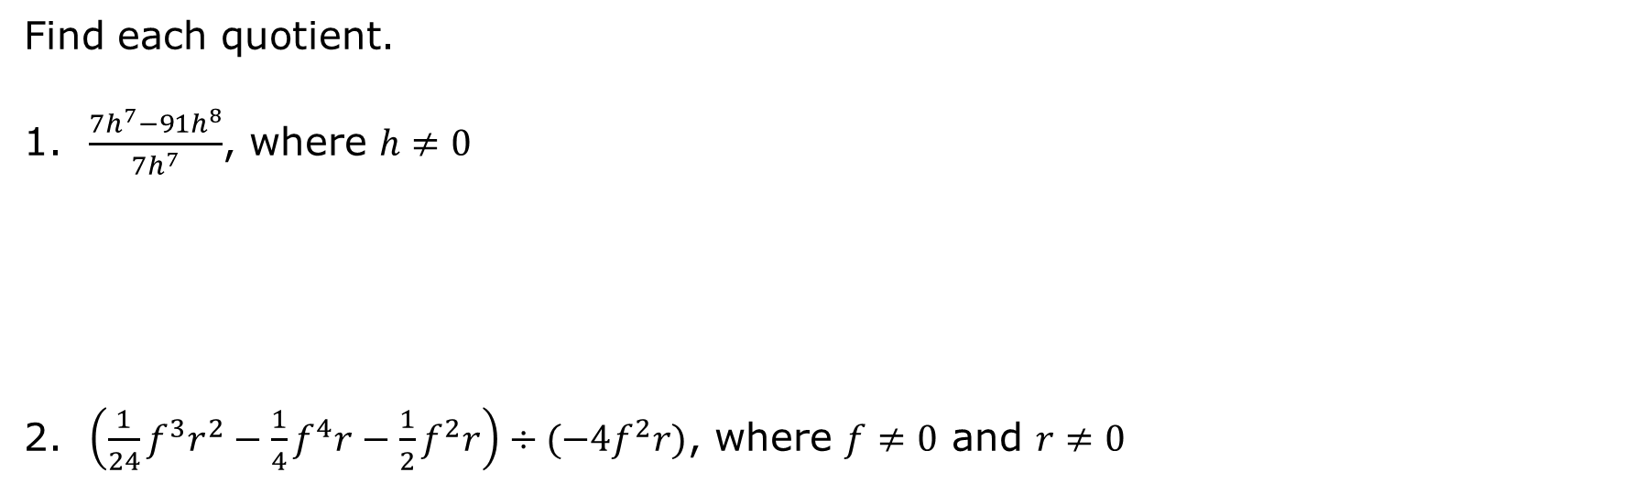
2.9.4 Your Turn!
Find each quotient.
$\frac{7h^{7}−91h^{8}}{7h^{7}}$, where $h≠0$
$\left(\frac{1}{24}f^{3}r^{2}−\frac{1}{4}f^{4}r−\frac{1}{2}f^{2}r\right)÷(−4f^{2}r)$, where $f≠0$ and $r≠0$
volume 1, pg. 104

Slide 18

Wrap-Up
volume 1, pg. 104

Slide 19
2.9.5 Wrap-Up: Reflection
What is something that is now “squared away” in your mind about adding, subtracting, multiplying, and dividing polynomials?
What are three “points” that are important about adding, subtracting, multiplying, and dividing polynomials?
What is something that is still “circling” your brain about adding, subtracting, multiplying, and dividing polynomials?
volume 1, pg. 104

